Slide 1
SAGE Smart Autonomous Hospital Digital Twin Predicting Tomorrow's Emergencies, Today
Team- TAURUS
College- BMSIT&M
Members- Abhishek N
Sanjana B
Bhuvan Mulka
Track 01
AI & Intelligent Digital Twins

Slide 2
The hospital crisis
1. 10–30% of hospital capacity is wasted
A significant portion of hospital beds are occupied unnecessarily or due to delayed discharges, reducing availability for critical patients. This directly leads to denied or delayed treatment despite physical infrastructure being present. 🔗 https://www.emro.who.int/emhj-volume-27-2021/volume-27-issue-7/inappropriate-hospital-stays-and-association-with-lack-of-homecare-services.html
2. 20%+ patients face critical delays due to overcrowding
Overcrowded hospitals cause long wait times (often 8+ hours), delaying timely treatment and worsening patient outcomes. Even advanced healthcare systems report 1 in 5 patients not treated on time due to flow inefficiencies. 🔗 https://www.commonwealthfund.org/publications/other-publication/2005/sep/preventing-hospital-overcrowding
3. Thousands of deaths linked to hospital flow failures
In England alone, over 16,600 deaths annually are associated with long emergency wait times caused by system bottlenecks. These are largely due to poor patient flow, bed management, and discharge inefficiencies—not lack of medicine or doctors. 🔗 https://www.theguardian.com/society/2025/dec/14/hospitals-in-england-face-dangerous-winter-overcrowding-due-to-discharge-delays

Slide 3
Problem Statement:
During peak hours and emergency situations, hospitals struggle with inefficient bed management, delayed patient care, and poor coordination between departments. Critical decisions—such as ICU allocation, patient transfers, and doctor assignment—are often made without real-time visibility or system-wide intelligence.
This results in:
Increased patient waiting times
ICU overload and mismanagement
Inefficient utilization of doctors and medical resources
Lack of transparency in hospital operations
Challenge:
Build a smart, simulation-driven hospital system that acts as a Digital Twin, allowing administrators and medical staff to:
Visualize hospital operations in real time
Manage beds and patients dynamically
Route patients efficiently across departments (ICU, labs, MRI, etc.)
Assign doctors intelligently
Handle emergency surges with system-driven recommendations
The solution should demonstrate how technology can transform hospitals into data-driven, adaptive, and intelligent systems.

Slide 4
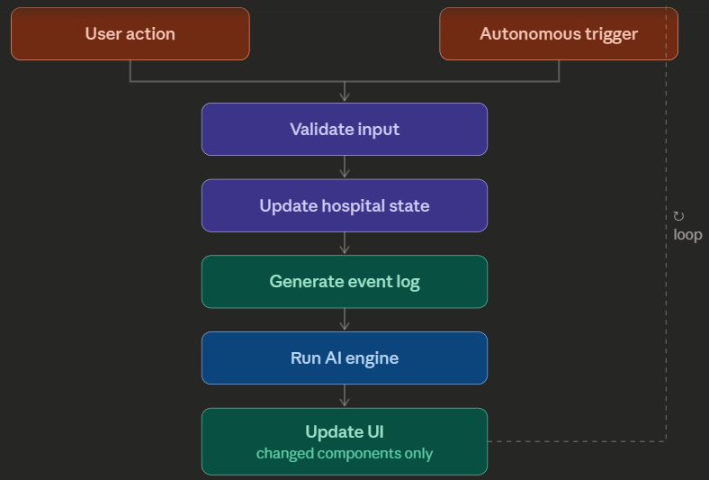
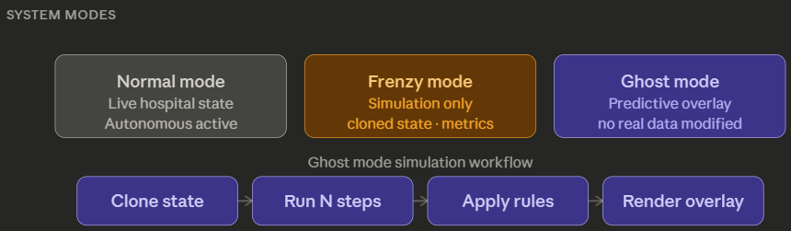
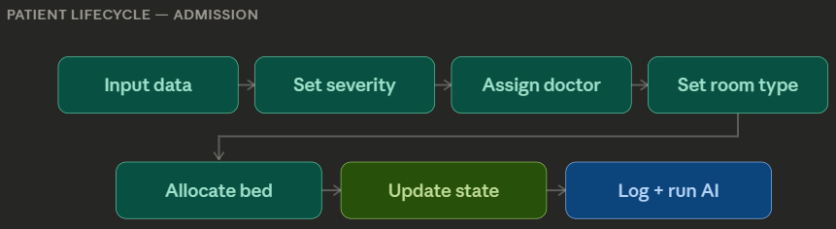
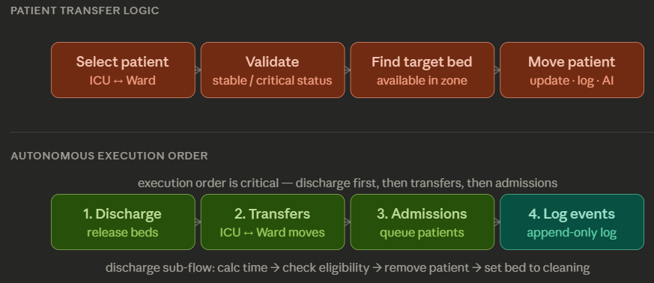
Overcoming nervousness
Confidence-building strategies

Slide 5
Implemented tech stack
Backend-Supabase (BaaS)
•PostgreSQL database
•Auth, APIs, real-time
Architecture
•Decoupled frontend & backend
•API-driven (REST/JSON)
•Scalable serverless system
Frontend-React + Vite
•Fast, component-based UI
•Responsive design
Deployment-Vercel
•Serverless hosting
•Global CDN + auto CI/CD
React (Frontend) + Supabase (Backend) + Vercel (Deployment)→ Fast, scalable, production-ready application

Slide 6
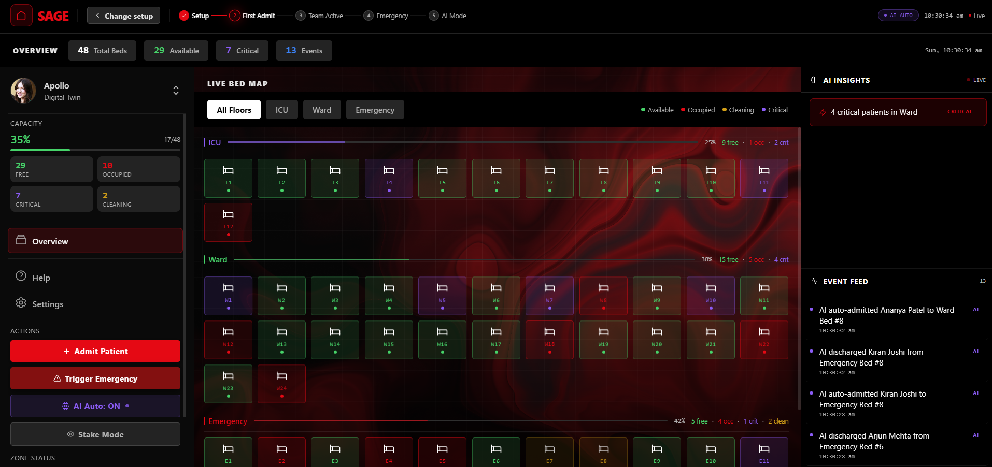
Engaging the audience
Make eye contact with your audience to create a sense of intimacy and involvement
Weave relatable stories into your presentation using narratives that make your message memorable and impactful
Encourage questions and provide thoughtful responses to enhance audience participation
Use live polls or surveys to gather audience opinions, promoting engagement and making sure the audience feel involved

Slide 7
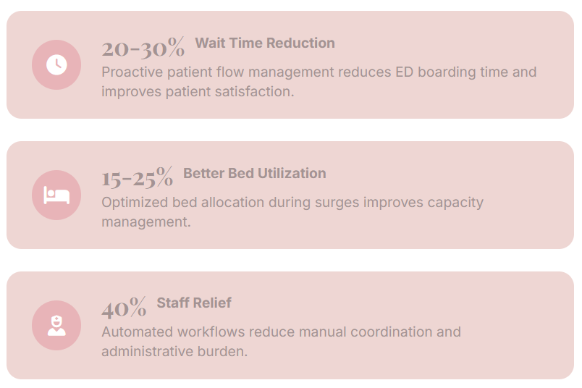
What Makes SAGE Different
Quantified Impact
Transforming Hospital Operations
SAGE delivers measurable improvements in hospital efficiency through real-time monitoring, predictive analytics, and automated decision-making.
Our system targets key performance indicators that directly impact patient care quality and operational costs.
* 20-30% reduction in ED boarding time
* 15-25% better bed utilization
* 40% reduction in manual coordination

Slide 8
Future Roadmap
EHR Integration & IoT
Seamless integration with existing hospital systems and IoT sensors for real-time data collection.
ADT feed integration
Bed sensor automation
Real-time status updates
Automated patient tracking
ML-Enhanced Predictions
Advanced machine learning models for predictive analytics and capacity planning.
Arrival rate prediction
Length of stay forecasting
Resource optimization
Pattern recognition
Multi-Hospital Networks
Scale to multi-facility networks with intelligent load balancing and transfers.
Cross-facility coordination
Patient transfer optimization
Resource sharing
Network-wide analytics

Slide 9
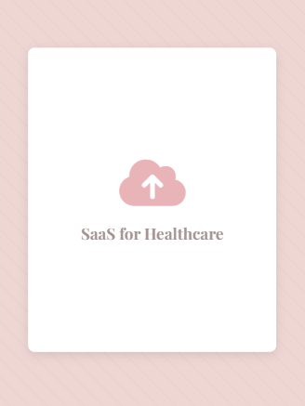
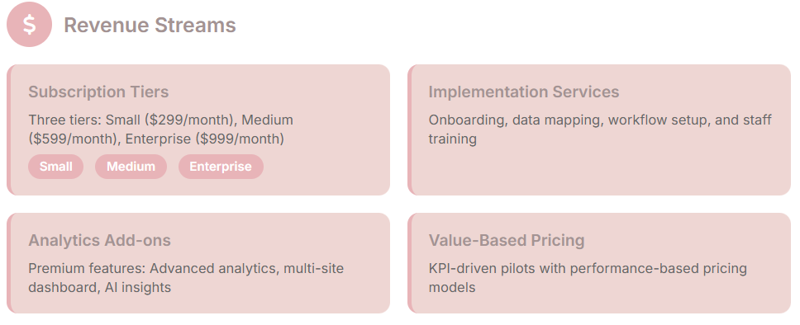
Business Model
SAGE operates on a SaaS subscription model with tiered pricing for hospitals of different sizes, implementation services, and premium analytics features.

Slide 10
Thank you
Now you can visit our Website link- SAGE

